Slide 1
My
PORTFOLIO
PORTFOLIO
Sophil Sthapit
Full Stack Web Development

Slide 2
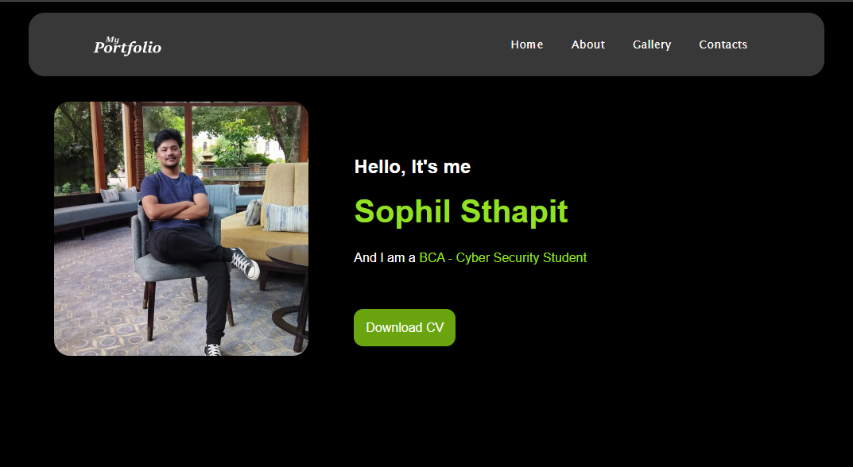
HOME
The Main Page of the portfolio website contains:
The Navigation Bar with a logo and navigation buttons:
Home
About
Gallery
Contacts
An Image of Myself
Introduction
Added link to downloading my CV
The Home Page

Slide 3
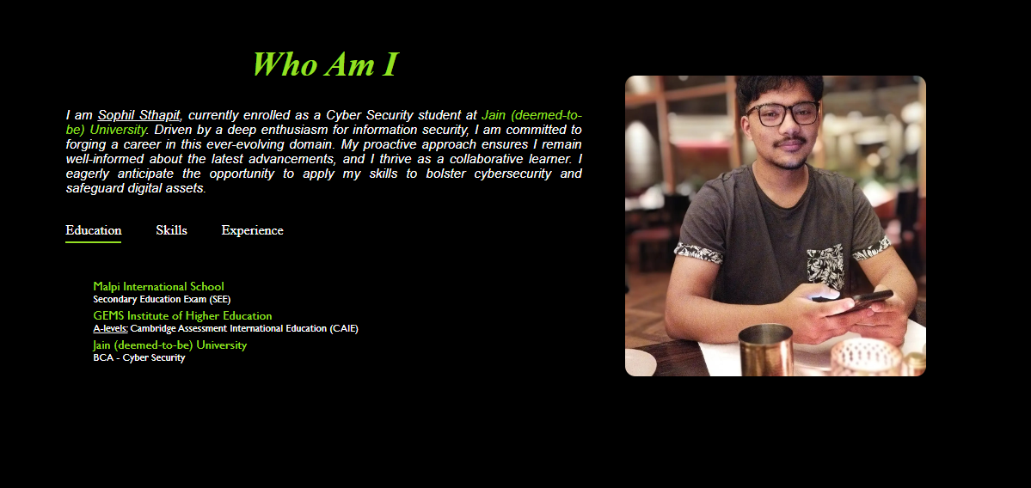
ABOUT
ME
The WHO AM I page consists of a paragraph that consists of a description about myself.
It showcases another self portrait of myself
It also consists of three columns
Education
Skills
Experience
The About Me Page

Slide 4


Slide 5
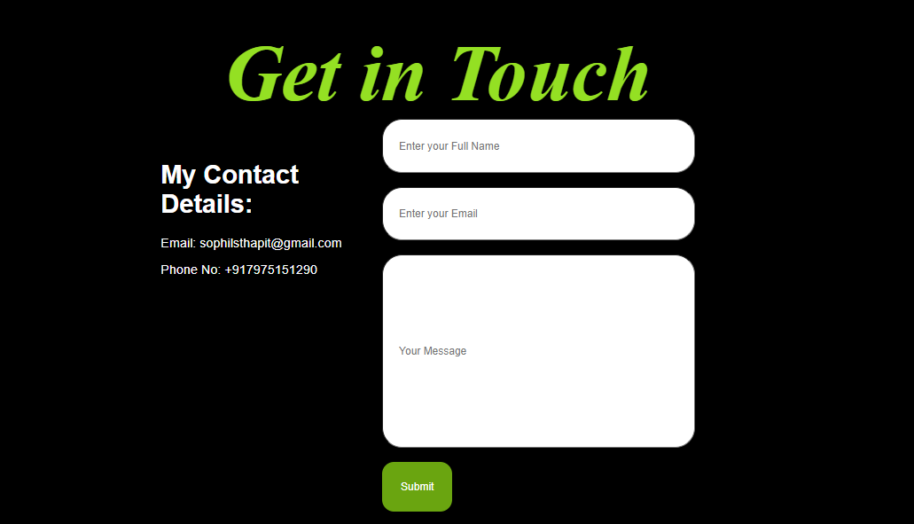
CONTACTS
This is the Final Page that displays two columns
One that consists of My Contact Details:
Email
Phone Number
Second that Consists of a form that is linked with the google sheets page
The form asks for the users name, email and the message they mean to send.
Finishing it with a submit button

